Slide 1

Tuesday, oct.2
You will need your notes and something to write with.
HW: Work on Textbook Questions and Online Quizzes

Slide 2
Modern Banking Functions
In the United States

Slide 3
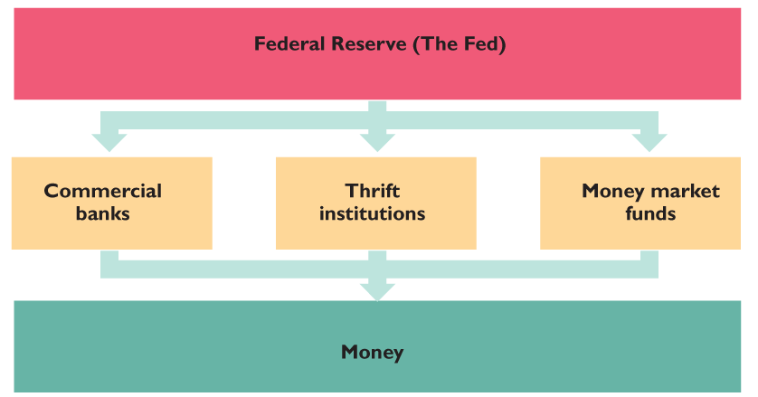

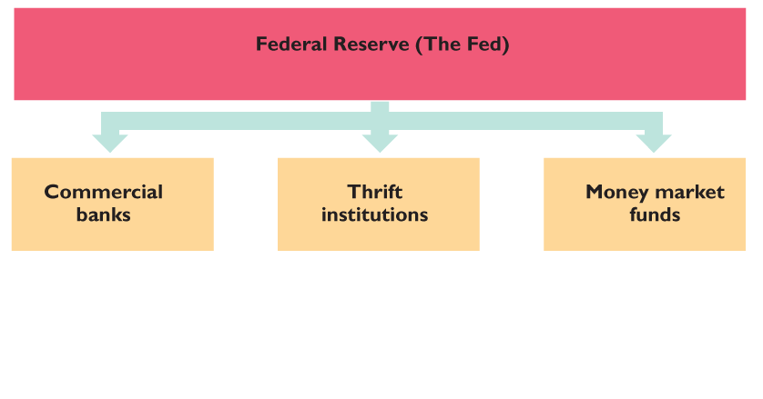
THE BANKING SYSTEM
The figure shows the institutions of the banking system.
The Federal Reserve regulates and influences the activities of the commercial banks, thrift institutions, and money market funds, whose deposits make up the nation’s money.

Slide 4
Functions of Banks
Storing Money- A safe, convenient place to keep your money.
Saving Money- Checking Accounts, Savings Accounts, Money Market Accounts, and Certificates of Deposit (CD’s)
Making Loans- Give people money in exchange for interest and repayment.
  Fractional Reserve Banking- When a bank only keeps a small portion (or fraction) of their funds and loan the rest out.

Slide 5

A Balancing Act: Profit and Risk
  Profit and Risk: The goal of a commercial bank is to maximize the long-term wealth of its stockholders.
  To achieve this goal, banks borrow from depositors and others and lend for long-terms at high interest rates.
  Lending is risky, so banks must try to make money but not jeopardize the funds of its depositors and the long term financial health of the bank

Slide 6

More Balancing: Profits and Liquidity
  Bankers pursue two other conflicting goals, Profits and Liquidity.
  Liquidity- assets that have the ability to converted into cash.
  The bank needs to lend money in order to make profits. But it also needs to have enough cash on hand to conduct daily business.

Slide 7

The Banking System, cont’d.
  To trade off between risk and profit, and profit and liquidity, a bank divides its assets into four parts:
    Reserves
    Liquid assets
    Securities
    Loans

Slide 8

Reserves
  A bank’s reserves consist of currency in the bank’s vaults plus the balance on its reserve account at a Federal Reserve Bank.
  The Fed requires the banks and other financial institutions to hold a minimum percentage of deposits as reserves, called the required reserve ratio.
  Any amount of reserves the bank holds above the required reserve ratio are called excess reserves.

Slide 9

Fractional Reserve System
When the Fed sets the Required Reserve Ratio (RRR) they are telling banks how much they must keep of each deposit they take in.
  Example: The RRR is 10%, so if someone deposits $1,000 into the bank, the bank must keep $100 of it on hand at all times.
This means that banks are able to then take the remaining funds from each deposit, and loan it out to draw interest.
  Using our first example, the bank would then be able to loan out $900.

Slide 10

How Banks Create Money

Slide 11

Liquid Assets
  Banks’ liquid assets are short-term Treasury bills and overnight loans to other banks.
  When banks have excess reserves, they can lend them to other banks that are short of reserves in an interbank loans market.
  The interbank loans market is called federal funds market and the interest rate on interbank loans is the federal funds rate.
  The Fed’s policy actions target the federal funds rate.

Slide 12

Securities and Loans
Securities held by banks are bonds issued by the U.S. government and by other organizations
  A bank earns a moderate interest rate on securities, but it can sell them quickly if it needs cash so they are quite liquid.

Slide 13

Securities and Loans, cont’d.
Loans are the funds that banks provide to businesses and individuals and include outstanding credit card balances
  Loans earn the bank a high interest rate, but they are risky and cannot be called in before the agreed date.
  If people default on their loans, or fail to pay it back, the bank can suffer.

Slide 14
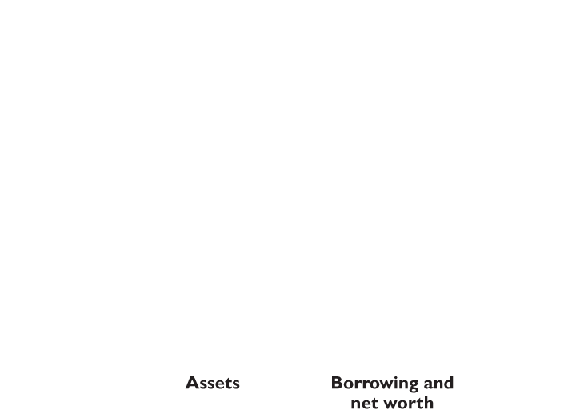
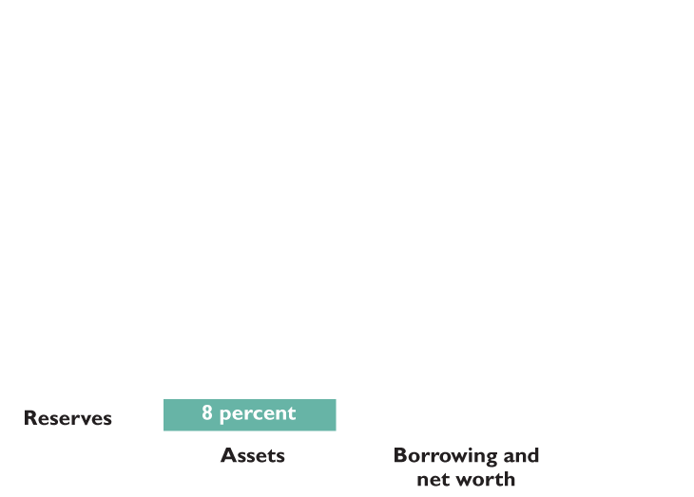
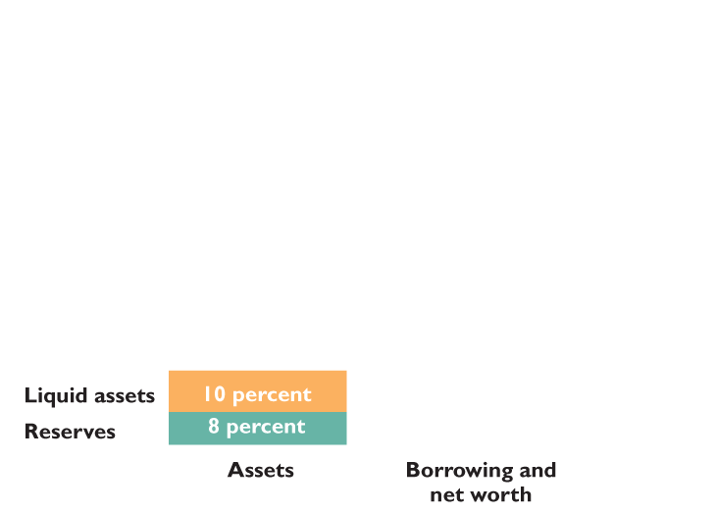
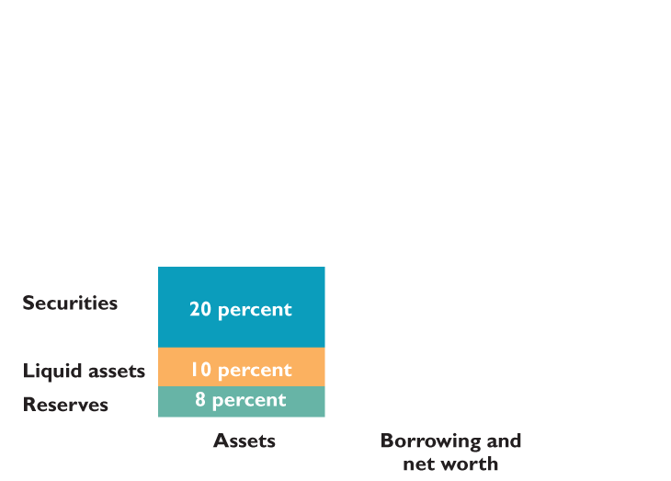
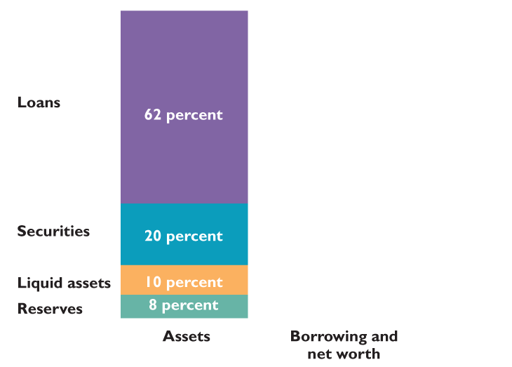
THE BANKING SYSTEM
  The figure shows that in 2009, commercial banks held :
  8 percent of total assets as reserves.
  10 percent as liquid assets.
  20 percent as securities.
  62 percent as loans.

Slide 15
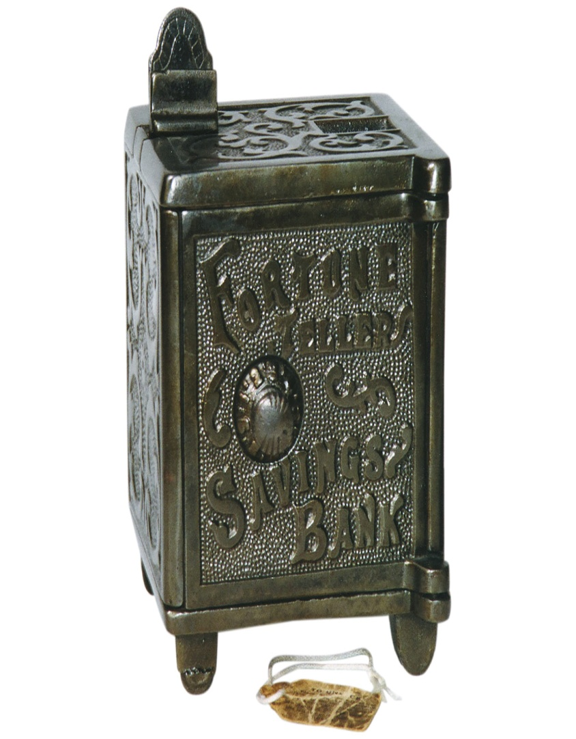
Types of Banks: Thrift Institutions
  A savings and loan association (S&L) is a financial institution that accepts checkable deposits and savings deposits and that makes personal, commercial, and home-purchase loans.
  A savings bank is a financial institution that accepts savings deposits and makes mostly consumer and home-purchase loans.

Slide 16

Thrift Institutions, Cont’d.
  A credit union is a financial institution owned by a social or economic group, such as a firm’s employees, that accepts savings deposits and makes mostly consumer loans.
  ****Like commercial banks, thrift institutions hold reserves and must meet minimum reserve ratios set by the Fed.

